Slide 1
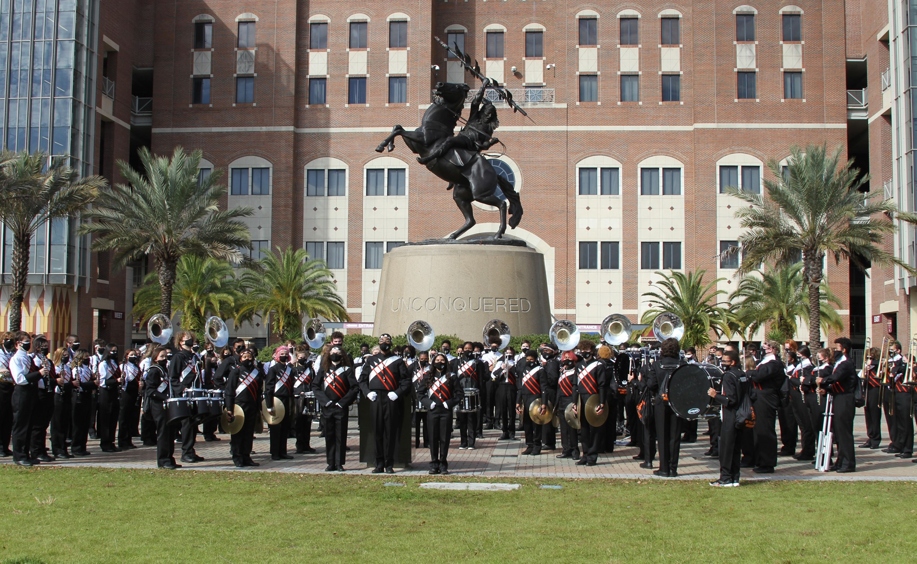
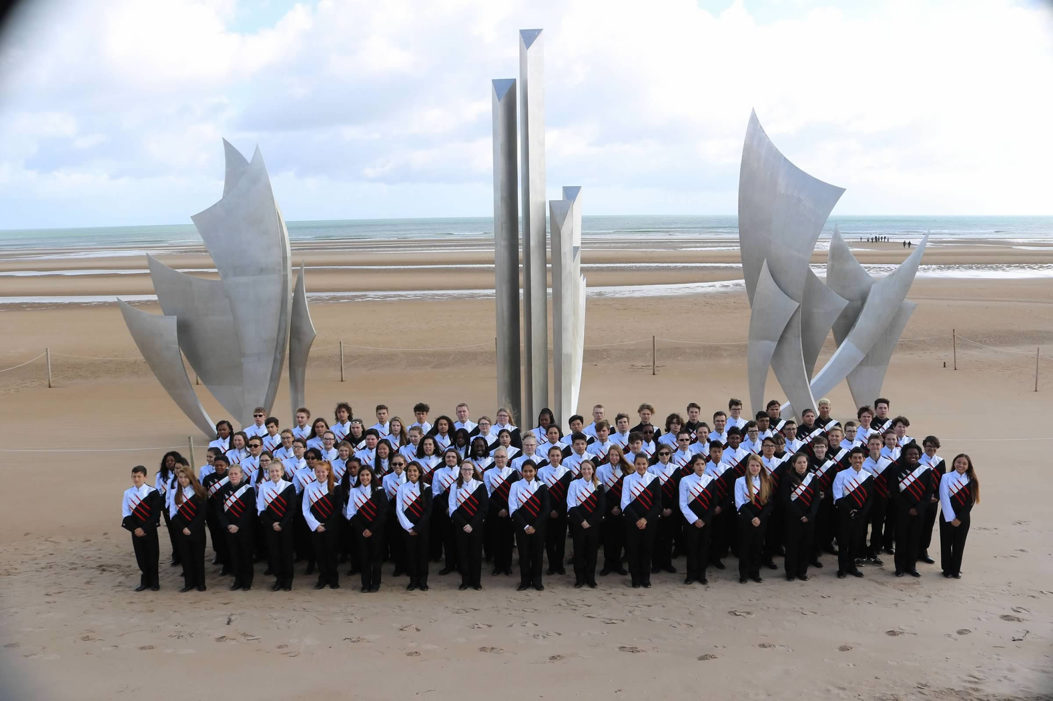
2023-2024 New Student Band Registration

Slide 2
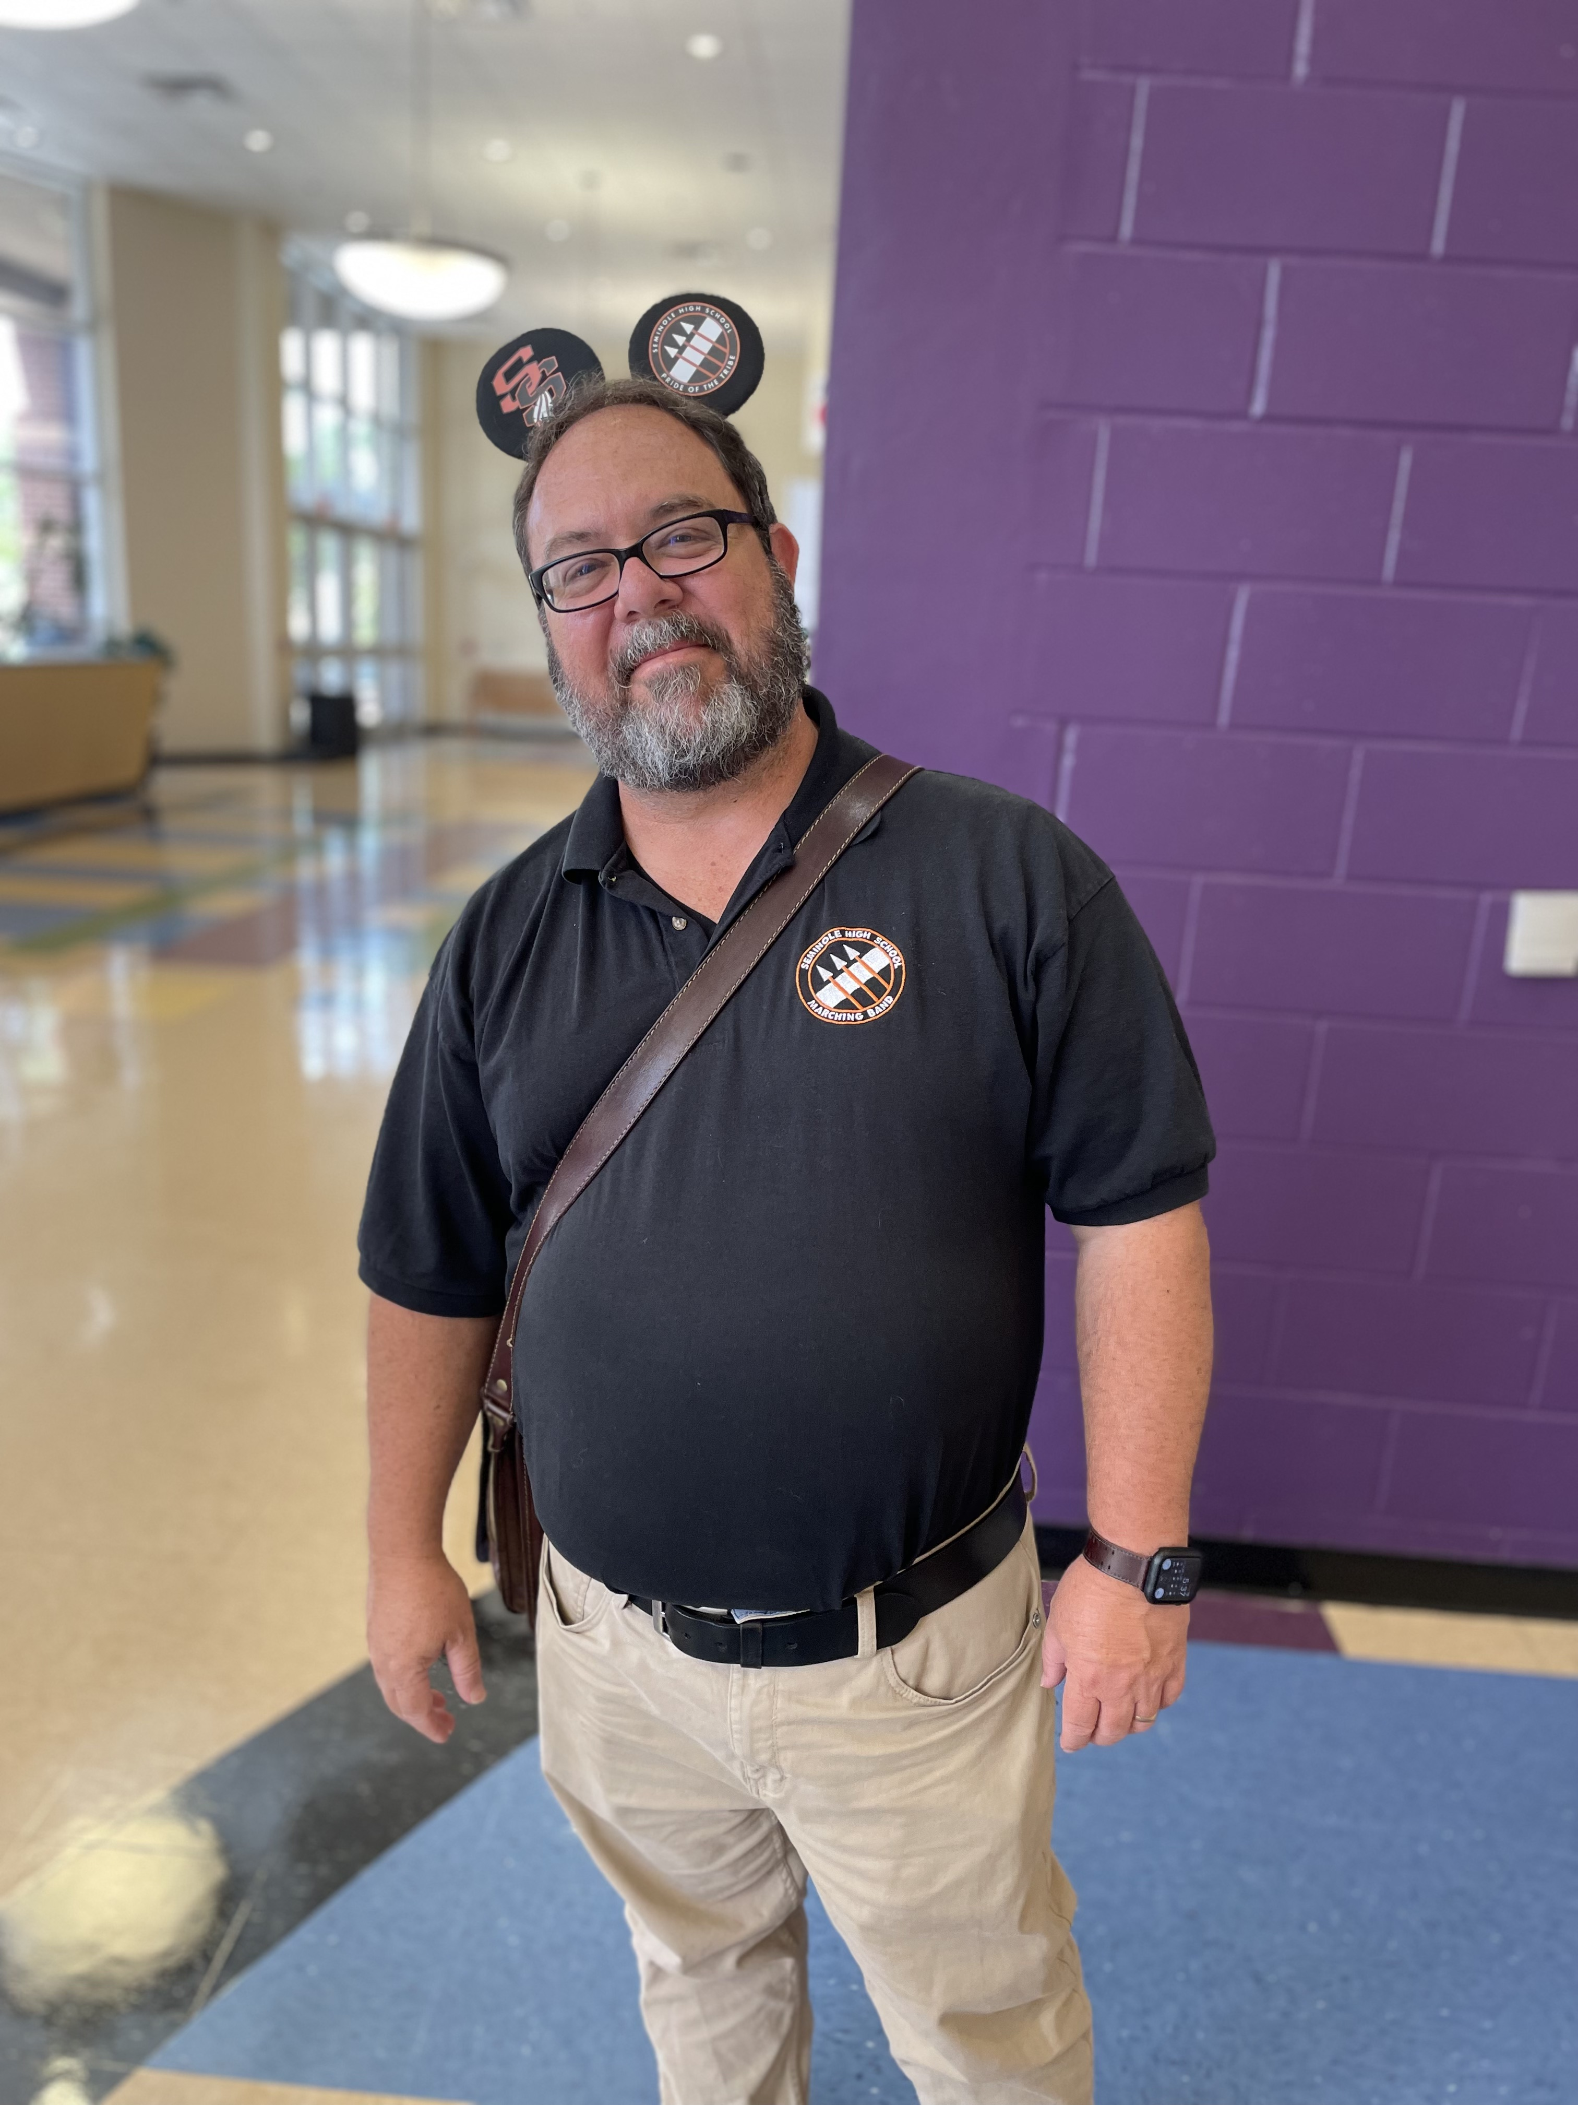
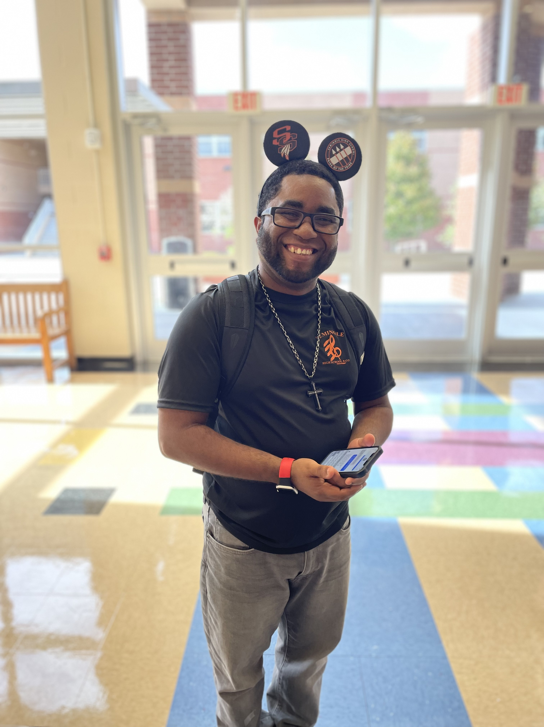

Slide 3
Overview of Tonight’s Events
Welcome (Auditorium)
BPA Overview
Communications
Band Camp Overview
Proceed to registration
Students Proceed to Uniform Fitting (Orchestra Room)
Parents Proceed to the Check Out Station (Chorus Room)
Notary for medical/transportation form
Make your payment
Students Are Assigned a Band Locker (Band Room)
Opportunity to purchase spirit wear
Instrument rentals are also taken care of here (rental fee mandatory for percussionists and sousaphones)
Both Parents & Students Head to Continuity Pick Up (Drama Room)

Slide 4
Band Parent Association (BPA) Meetings the second Tuesday of every month @6:30PM; all are welcome to attend. Main campus band room.
SHS Band Parent Association
The BPA is the band booster organization. We help to support the band through fundraising and organizing volunteers for band events. Dues are $25 per year per family and go towards supporting the students year-round.
Opportunities to Volunteer
Chaperoning Marching Fest, MPA events or helping with other Band events
Our By-Laws and current list of officers can be found on the Band Web Site
www.seminolehsband.org
Chaperoning Football Games
Join a Committee (hospitality, media, equipment, etc)

Slide 5
Budget Summary
BPA 2023/2024 Budget
$120,000 Operating Budget
Income Streams
Band Dues: $55,000
BPA Membership Dues: $2,000
Fundraisers: $55,000
The more participation we have in our fundraisers, and the more families we have join the BPA, the lower we are able to keep our dues. We also are always looking for help, either chaperoning or helping to plan and execute band events.
Dues: New Students (Band): $375
All Guard: $450 (now) plus $200 (winter)

Slide 6
General Spending
Having guest clinicians during band camp (& periodically throughout the school year)
Buying rights to the music that the students play throughout the year/ and paying for marching charts to be created
Renting a truck for each away game, paying for tolls and gas
Dry cleaning all marching uniforms several times a year

Slide 7
General Spending (cont’d.)
Entry fees to festivals and musical performance assessment events
Catering Senior Night
Maintaining school-owned instruments
Purchasing school-owned instruments
Renting a venue/ providing catering for end of year Band Banquet
Operational fees of the organization (insurance, CPA fees for the tax return, etc)

Slide 8
ADDITIONAL EXPENSES THAT MAY OCCUR:
ITEMS INCLUDED WITH THE BAND DUES
USE OF A MARCHING UNIFORM
CONTINUITY:
YOU WILL RECEIVE TONIGHT: practice shirt, practice shorts, polo shirt, cinch bag
YOU WILL RECEIVE AT A LATER DATE: show shirt, Dinkles, gloves, lyre
SPIRIT WEAR
INSTRUMENT RENTAL (if applicable/available)
INSTRUMENT REPAIR
TRIP FEES

Slide 10
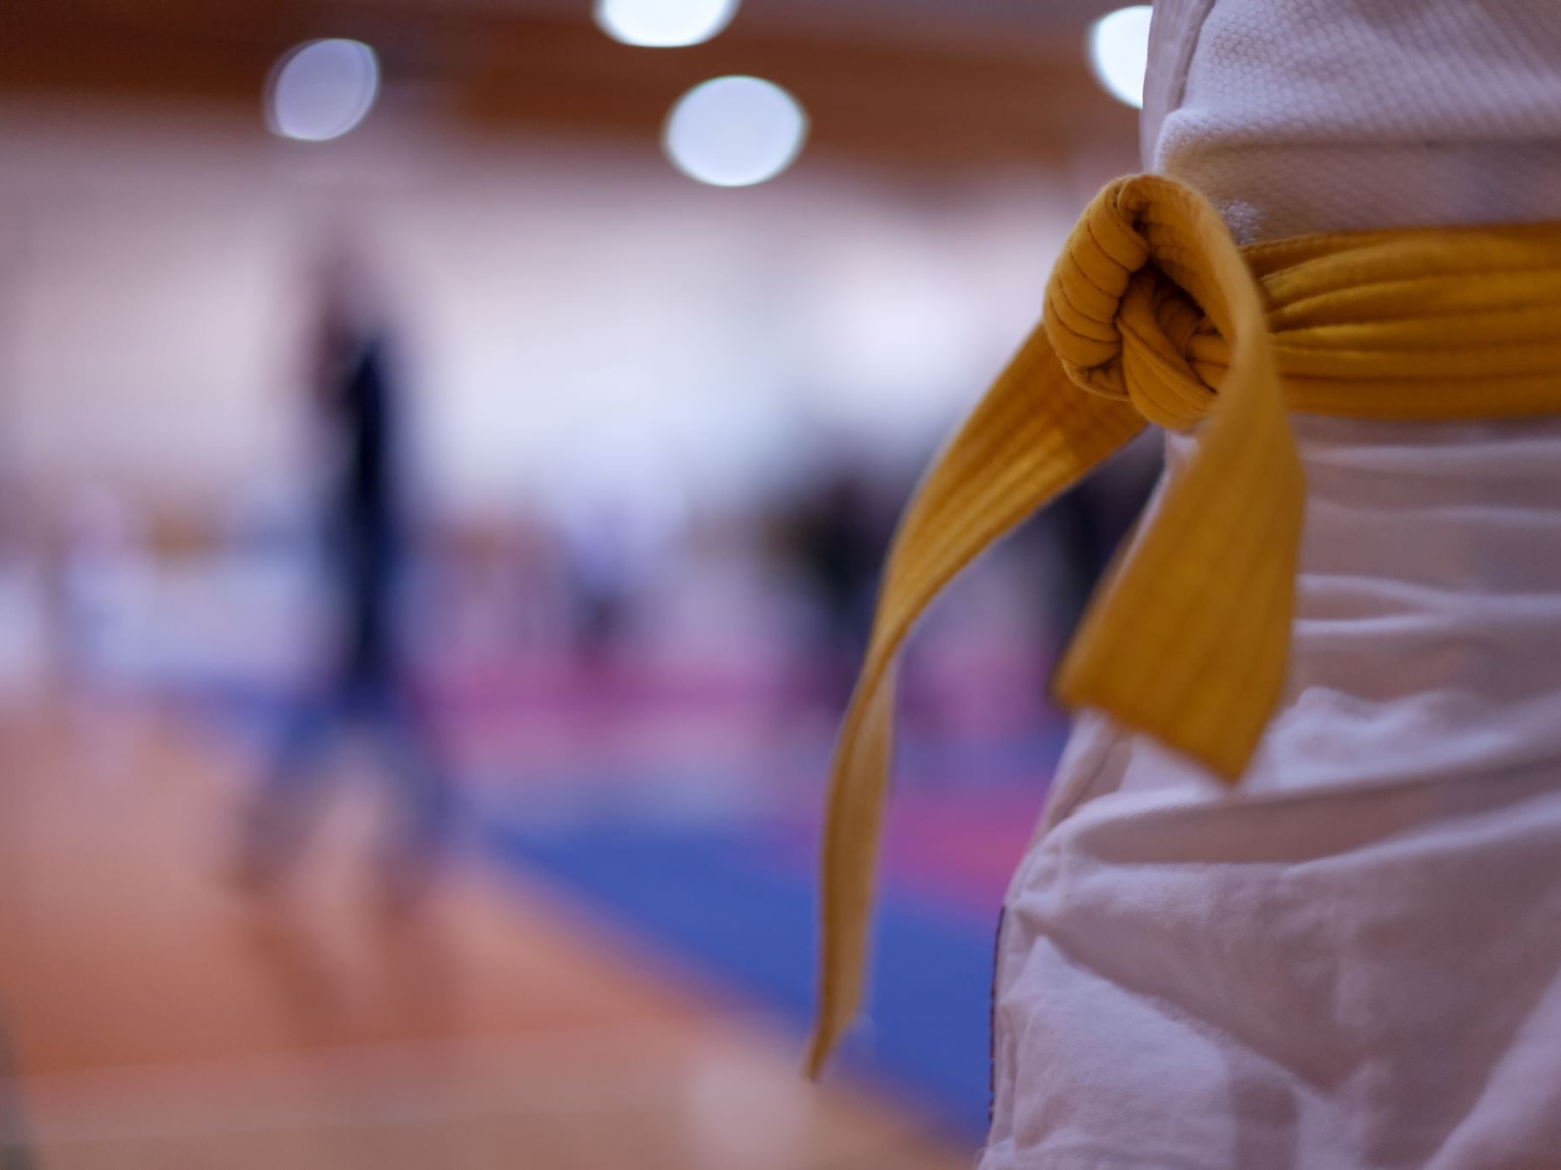
ITEMS INCLUDED WITH THE GUARD DUES
Use of: (meaning they will have to return)
spirit uniform (this year this is the marching uniform)
marching uniform
winter guard uniform
flag bag
equipment
Issuance of: (meaning they get to keep)
practice shirt
show shirt (both marching & winter guard)
polo shirt (1st year only)
cinch bag (1st year only)

Slide 11
OTHER ITEMS GUARD MEMBERS NEED (2)
Will Need to Purchase Separately: (but still required)
undergarments (including dance belts for males)
shoes
tights (*possibly, based on uniform needs)
makeup
hair accessories/jewelry
warm up jacket
Optional Items Available for Purchase: (a la carte pricing)
backpack
gloves

Slide 12
Other Expenses Guard Program Incurs: (covered by dues)
FFCC registration fee
winter guard floor tarp
clinician fees
dry cleaning
ADDITIONAL EXPENSES THAT MAY OCCUR:
SPIRIT WEAR
EQUIPMENT REPAIR
TRIP FEES

Slide 13
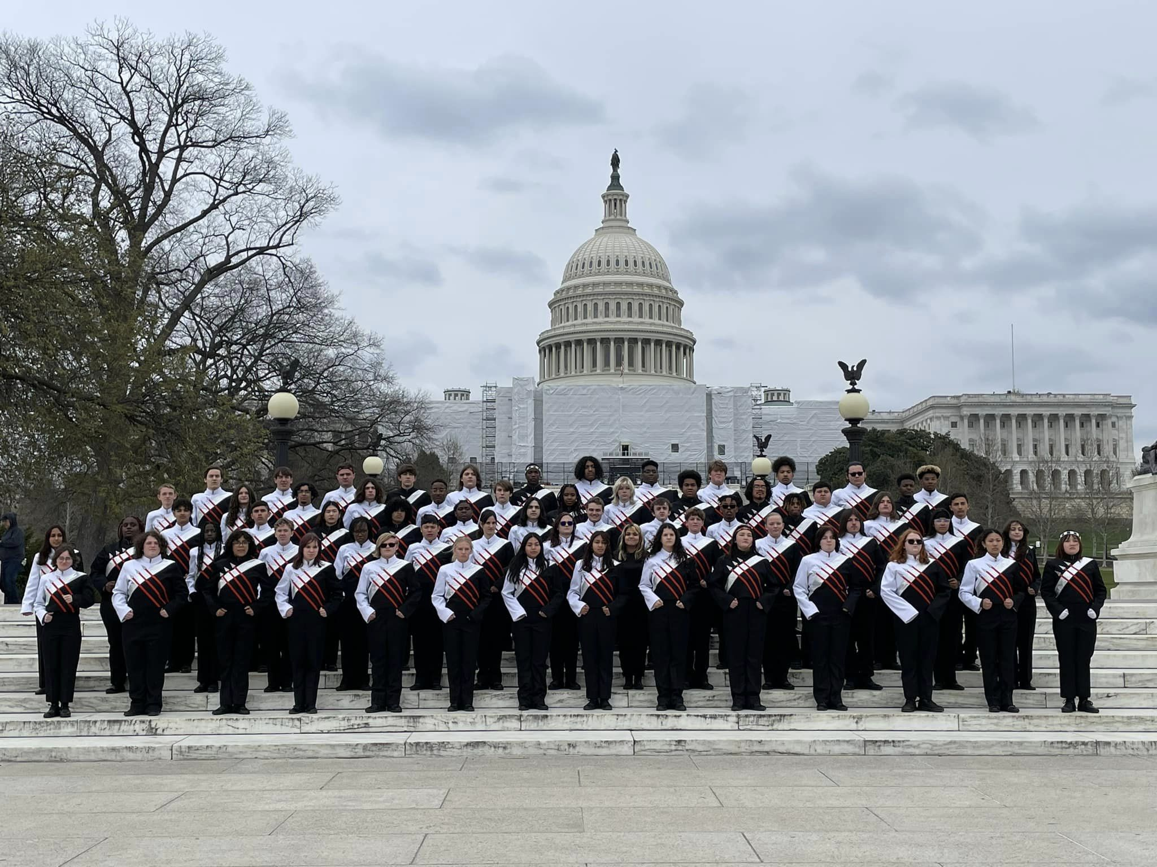
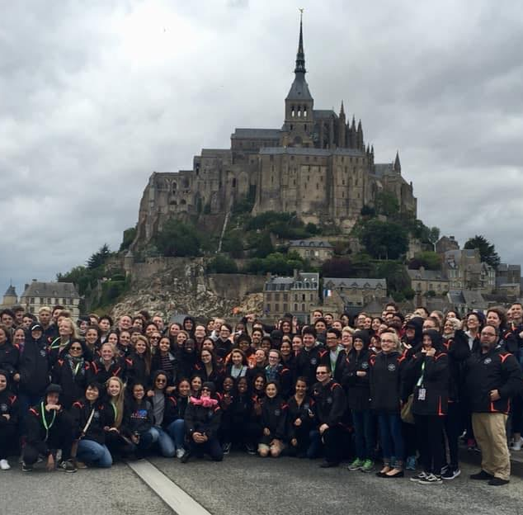
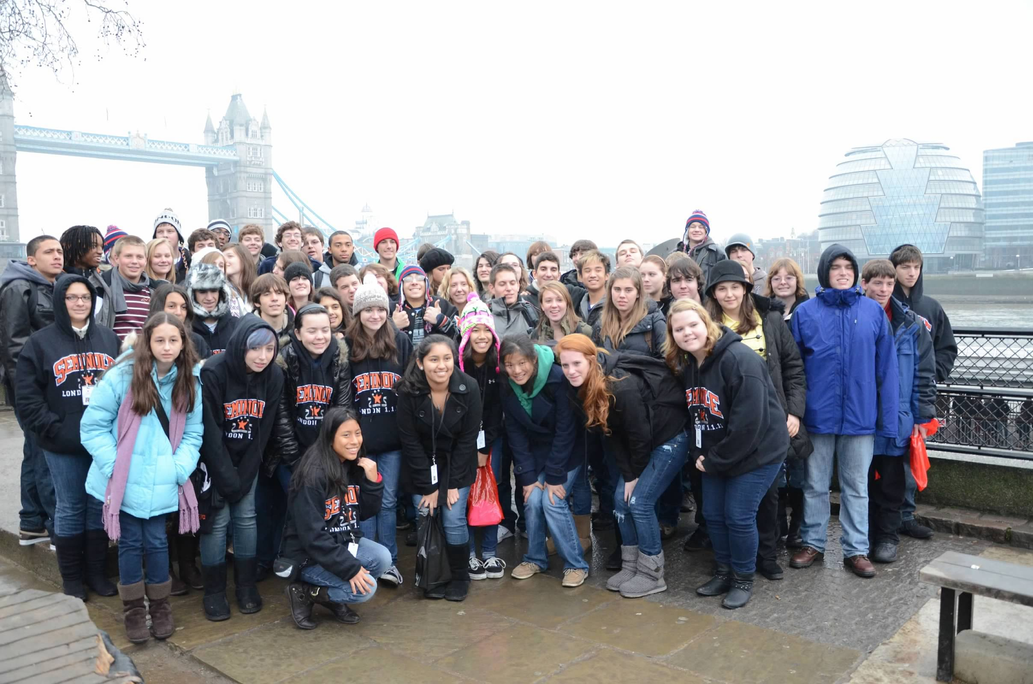
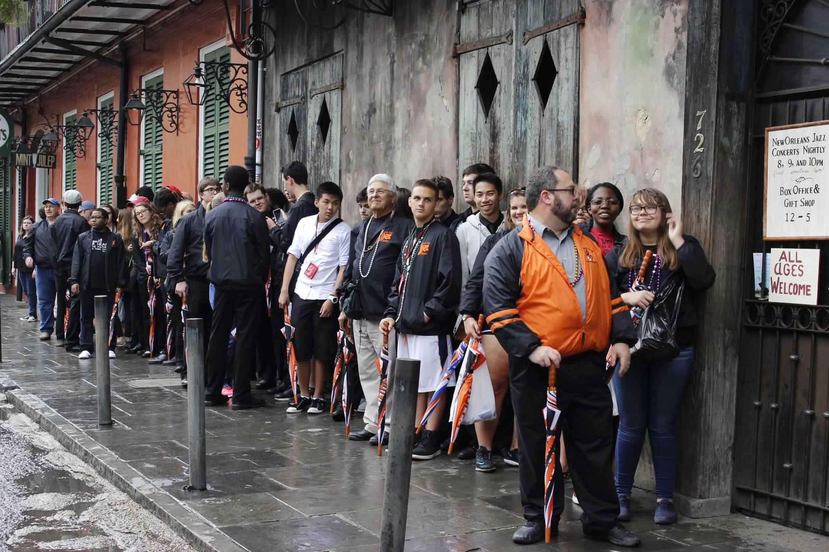
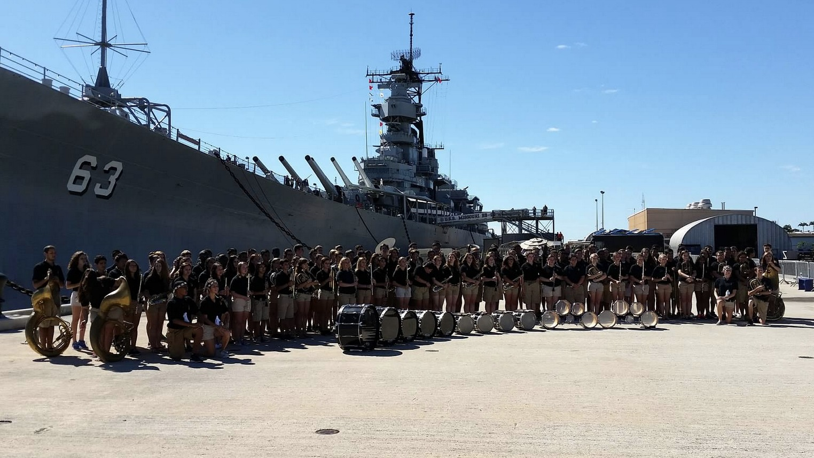
BAND TRIPS
WASHINGTON DC
FRANCE
LONDON
NEW ORLEANS
WAYS TO EARN $ TOWARDS TRIP FEES:
Quarterdays
Snowcone Sales
HAWAII

Slide 14
NEXT BIG TRIP: ROME!!!
YOU CAN STILL JOIN THIS TRIP!
must get a valid US Passport ASAP
must let Mr. Malcolm know no later than 8/21/23

Slide 15
COMMUNICATIONS -The Official means of communications are: the band website, emails (subscribe on the band website), Facebook -Our student communications team also manages an Instagram account, our Guard program also has a Band App group and an Instagram account, percussion has an Instagram account too
Pride of the Tribe Website
Social Media
Facebook - Pride of the Tribe (private group), Seminole High School Band Events (public page)
Instagram – shstribe, seminolesguard, seminolehspercussion
Email
Make sure you’ve signed up to get band emails on the band website (CONFIRM SUBSCRIPTION)
www.seminolehsband.org
For football games: email will go out, you can fill out request form online, our chaperone coordinator will email you if you’ve been selected to volunteer that week

Slide 16
Important Contact Info
PL Malcolm: BAND DIRECTOR | pl_malcolm@scps.k12.fl.us
Kenny Hargett: BAND DIRECTOR | kenneth_hargett@scps.k12.fl.us
Mandy Burkhart: SHS BPA President | president@seminolehsband.org
Joelis Pacheco: SHS BPA VP Operations | vp-operations@seminolehsband.org
Angela Tiffany: SHS BPA Director of Finance| treasurer@seminolehsband.org
Ray Burkhart: SHS BPA Chaperone Coordinator | chaperone@seminolehsband.org
ALL CONTACT INFO CAN ALSO BE FOUND ON OUR WEBSITE:
www.seminolehsband.org

Slide 17
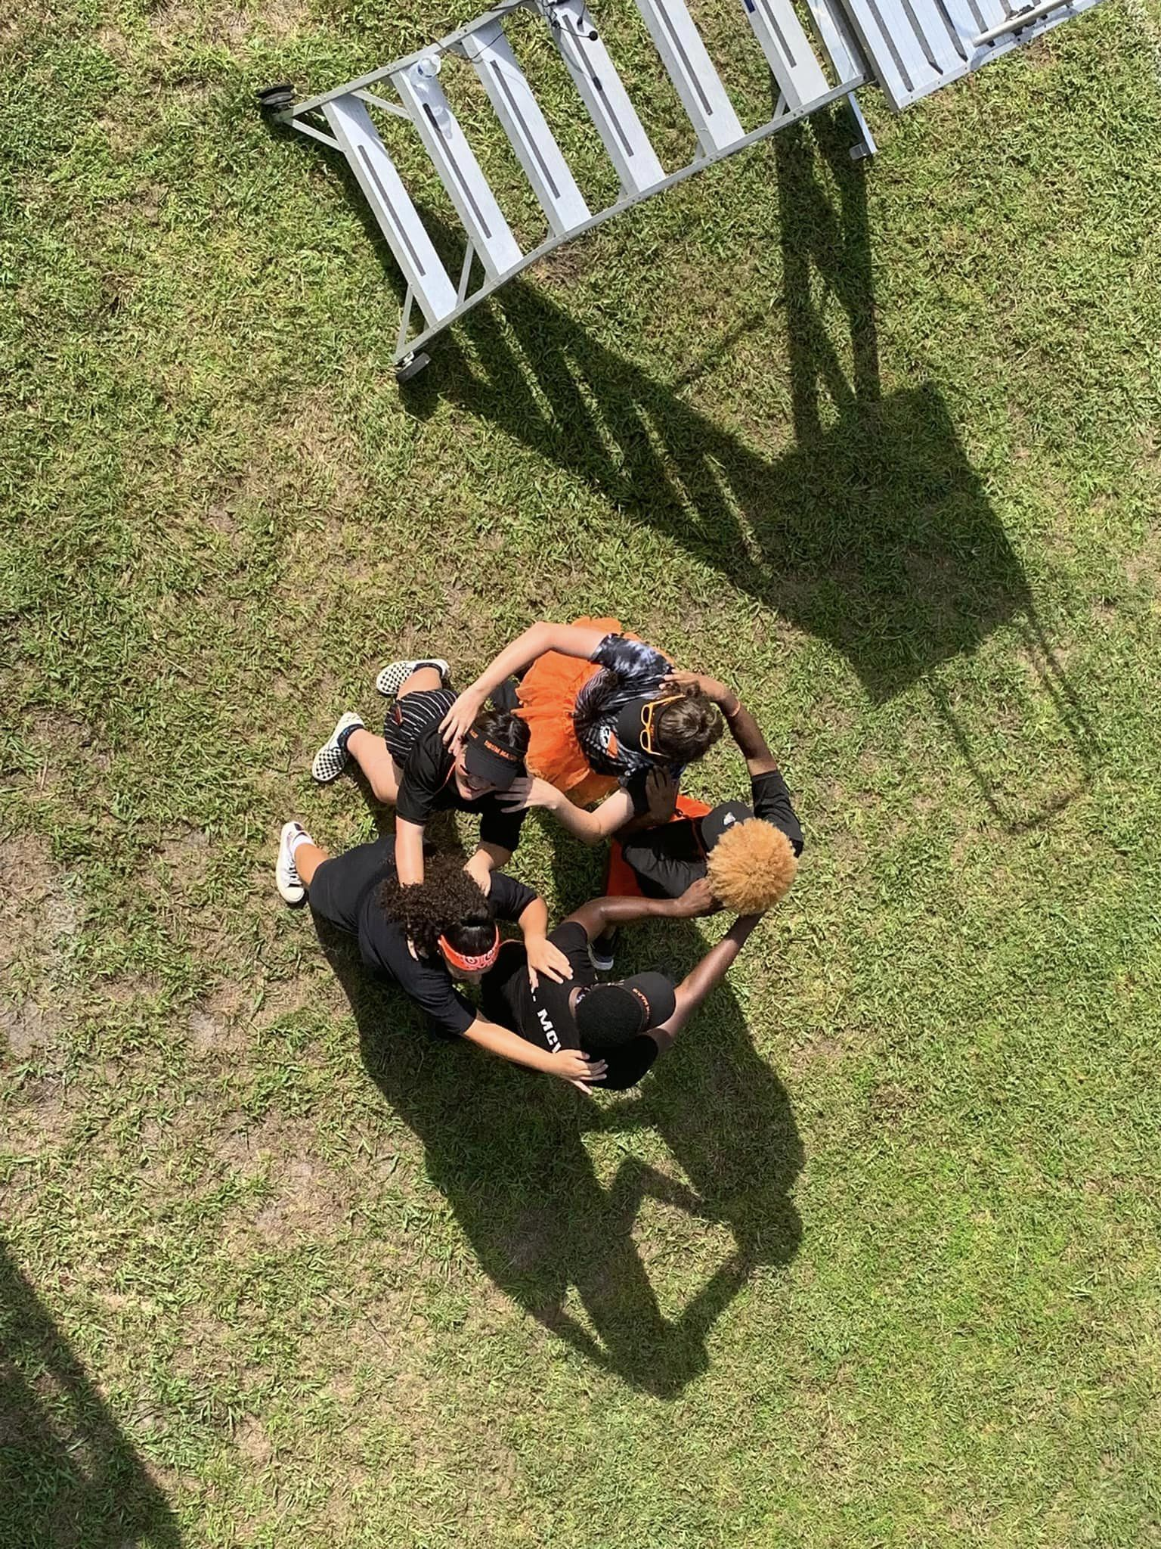
BAND CAMP

Slide 18
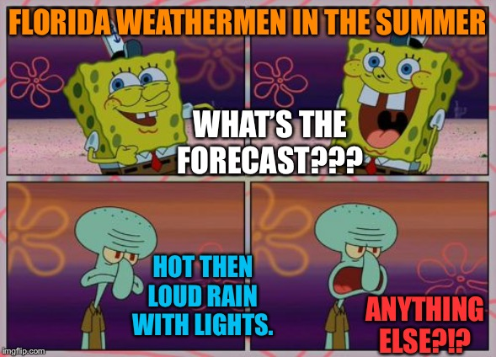

Slide 19
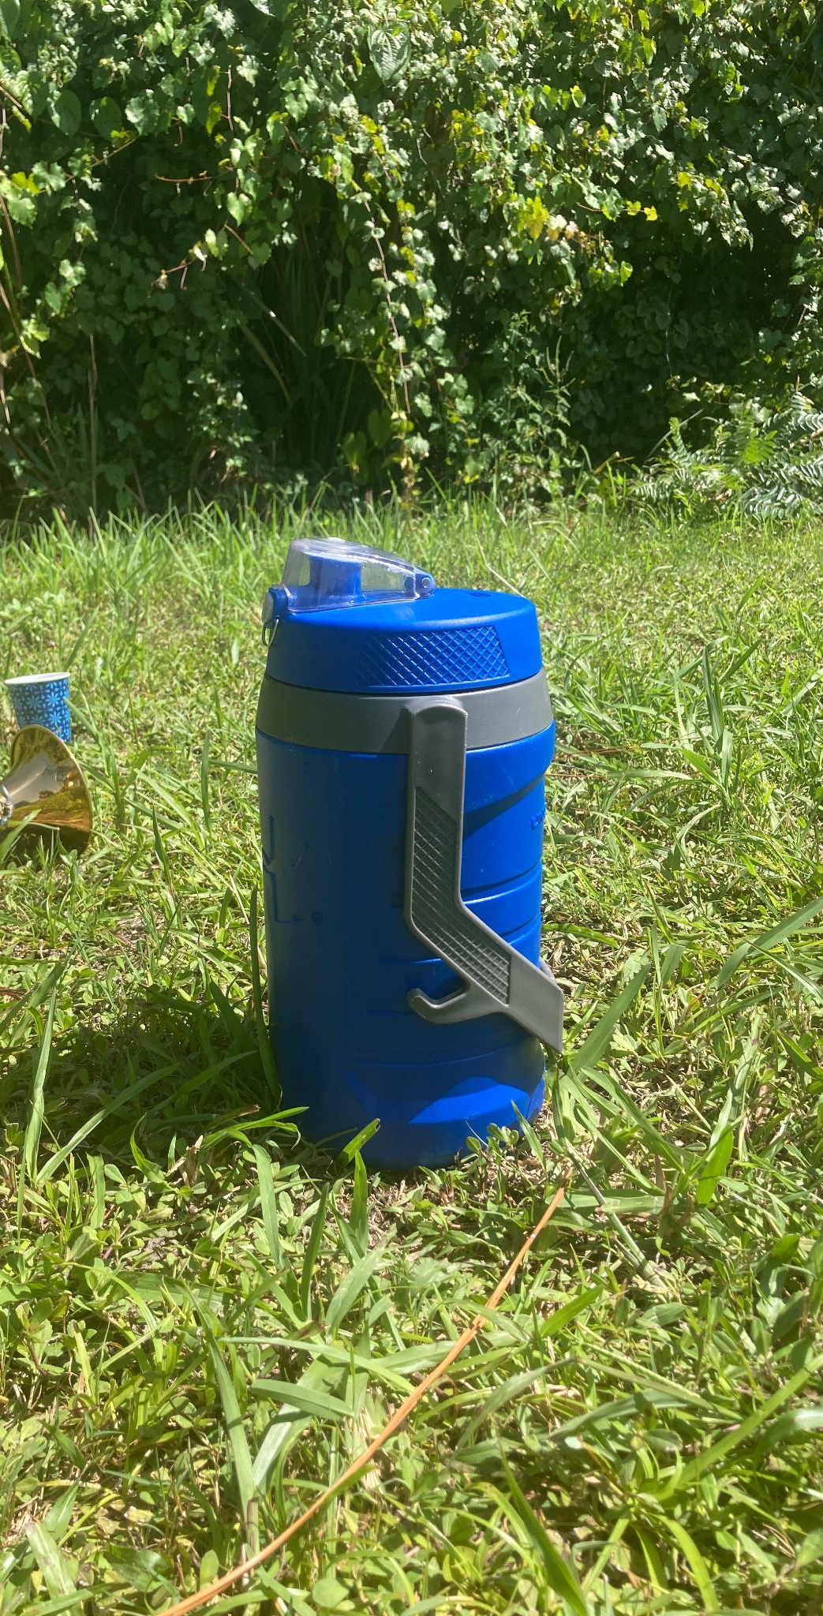
Band Camp 101 - Essentials
YOUR STUDENT NEEDS TO COME TO CAMP:
Well rested
Well hydrated
Water is good, Gatorade is better
Well fueled
Having eaten breakfast each day
BRING EVERY DAY:
Water jug
Lunch from home/snacks
Sunscreen
Deodorant
Hat/visor/sunglasses to be worn outside
Instrument (mouthpiece/extra reeds, etc)
Possibly: extra shirt/socks, cooling towel
DID WE MENTION YOUR STUDENT NEEDS TO BRING A WATER JUG EACH DAY?????

Slide 20
BAND CAMP MEALS
Breakfast: eat at home, every morning
Lunch: bring your own, every day
Dinner: either order meals through the band boosters or bring your own
DINNER ORDERS MUST BE PLACED TONIGHT! ABSOLUTELY NO MEAL DELIVERIES ALLOWED (Grub Hub, Uber Eats, etc.)
DAY | MEAL | SINGLE ($7) | DOUBLE ($11)
MONDAY | PIZZA (DOMINO’S) | 2 SLICES | 4 SLICES
TUESDAY | CHICK FIL A | 1 SANDWICH | 2 SANDWICHES
WEDNESDAY | BURGERS (BEEF/BEAN) | 1 BURGER | 2 BURGERS
THURSDAY | PIZZA (DOMINO’S) | 2 SLICES | 4 SLICES
FRIDAY | BOJANGLES | 2 TENDERS, BISCUIT, MAC & CHEESE | 3 TENDERS, BISCUIT, MAC & CHEESE

Slide 21
Band Camp Dinners
STUDENTS:
if you have not already signed up for band camp dinners you need to have this google form completed before you leave this room.

Slide 22
DONATIONS NEEDED
Cases of soda (coke, sprite, dr. pepper, root beer, etc)
Individually packaged chips and cookies (single serving size)
Cans of Gatorade mix (powdered)
Reams of plain white copy paper
ALL DONATIONS CAN BE DROPPED OFF ANYTIME DURING BAND CAMP WEEK! THEY CAN BE DROPPED OFF AT THE RAMP!

Slide 23
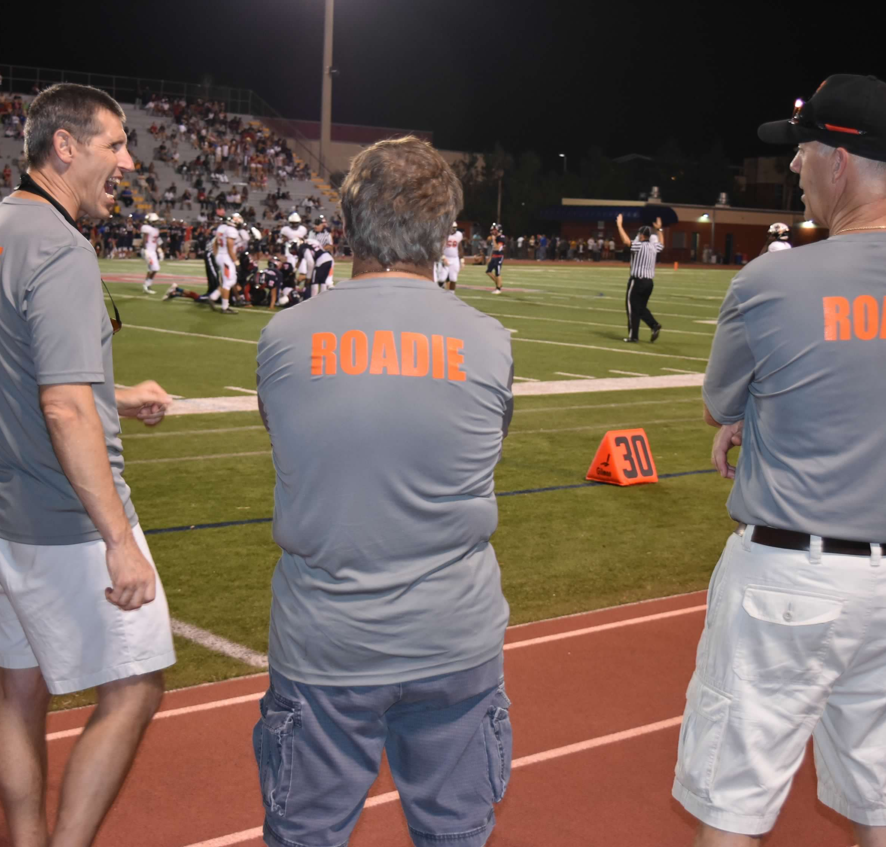
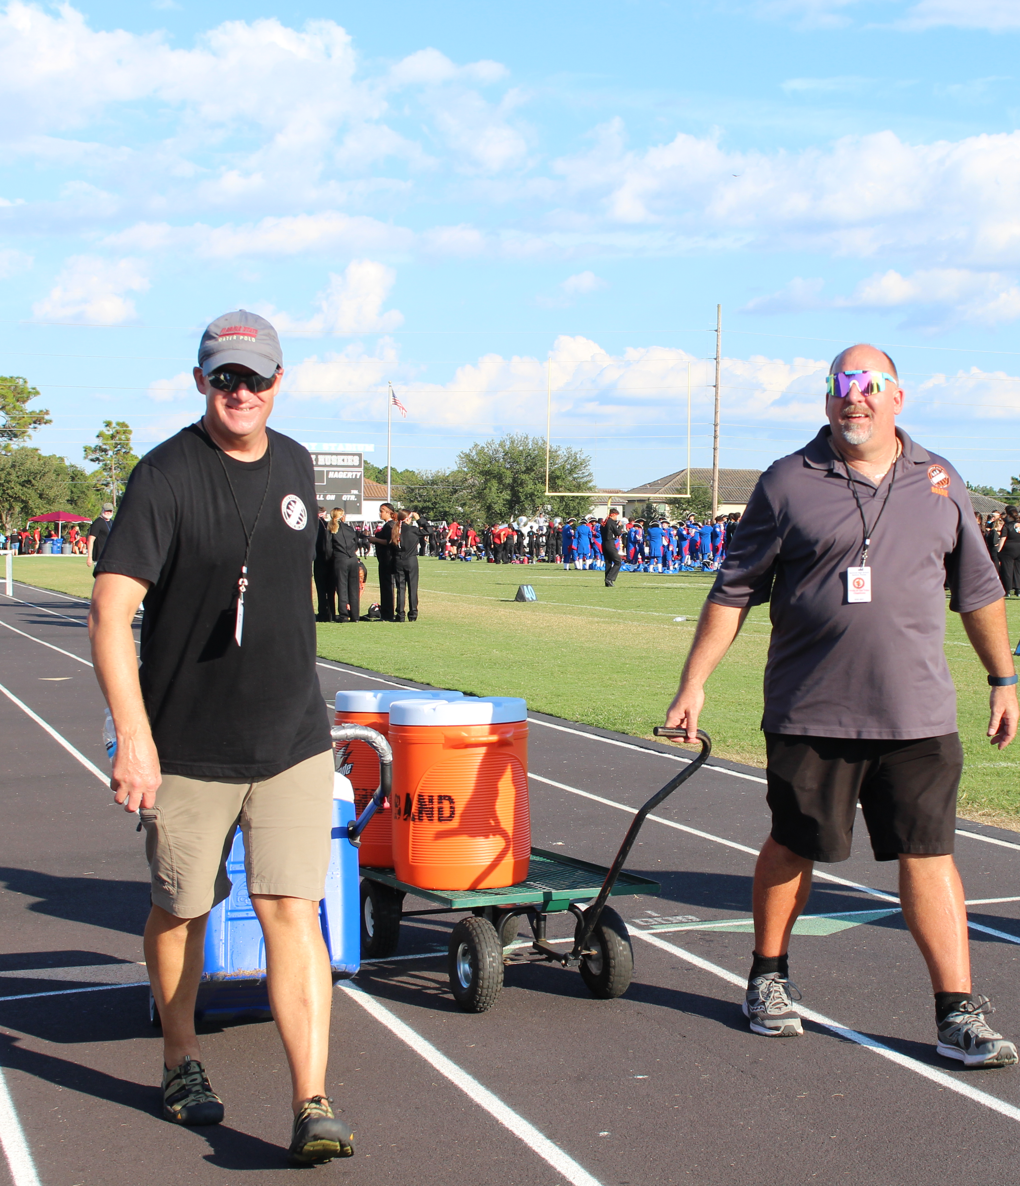
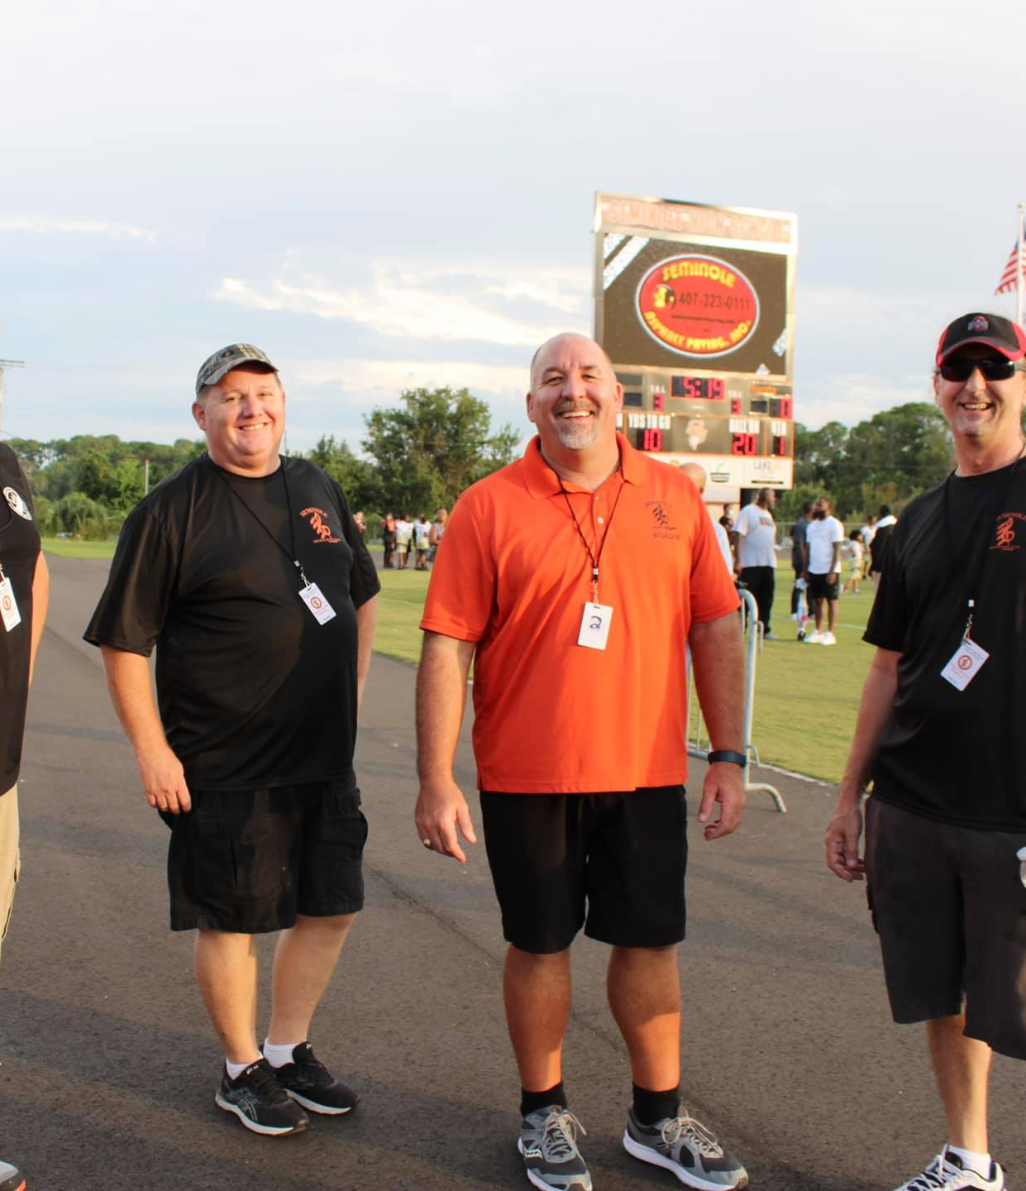
WE NEED SOME ROADIES!! DADS! We need your help! -must be able to: stand for long stretches of time, lift and carry 50 lbs -must be available Friday afternoons and evenings during marching season, as well as several Saturdays during marching season If you are able to volunteer as part of our equipment team this next school year, send an email to: chaperone@seminolehsband.org

Slide 24
1st Semester at a Glance
Marching Rehearsals: Tuesdays and Wednesdays until 5PM
Football Games: Friday nights, first home game 8/18 (Kickoff Classic)
Marching Fest (*all day event): Saturday October 21 (@LMHS)
Marching MPA (*all day event): Saturday October 28
Fall and Winter Concert Series: Veteran’s Day concert, Winter Band Concert
Parades: Homecoming Parade, Sanford Christmas Parade
*calendar can be found on our website www.seminolehsband.org

Slide 26
YOU MUST BE A DIVIDEND TO VOLUNTEER WITH US!
REGISTER AS A DIVIDEND/ renew your dividend application EACH YEAR BY FOLLOWING LINK IN QR CODE
Seminole HS gets credit for the hours you volunteer and this counts towards our school’s rating and funding!

