Slide 1

2025-2026 New Student Band Registration

Slide 2
Agenda
Band Finances
Communications
Registration Night
Fundraising
Band Trips
Band Camp Week
Volunteers
Welcome

Slide 3




Communication is the KEY!
Get Connected and stay up to date
Calendar of Events:
Email
Social Media
Apps
Google Calendar
At a Glance Calendar
(per semester)
FACEBOOK
  Pride of the Tribe –managed by BPA
GroupMe
(Receive just updates/info)
GroupMe
(Q &A ability)
Band App-
utilized by some individual sections.
Go to website:
**You MUST subscribe
**Confirm email
INSTAGRAM
shstribe
(student leadership)
seminoleguard
(Guard coach)
seminolehspercussion (Percussion Captain)
www.seminolehsband.org

Slide 4
At a Glance Calendar
HOPOEWAW Day
Tomorrow 9-1
Band Director Info
Student Account Balances- email treasurers @ treasurer@seminolehsband.org
Report Times
Remember:
Early is On Time
On Time is Late
Late is Really Late
Report times mean the students should be ready to perform with hair, make-up, uniform, instrument/ equipment ready to go
Concerts for the Year
Rehearsal Times

Slide 5

Budget Summary
BPA 2025/2026 Budget
$135,000 Operating Budget
Income Streams
Band Dues: $55,000
BPA Membership Dues: $2,000
Fundraisers: $55,000
The more participation we have in our fundraisers, and the more families we have join the BPA, the lower we are able to keep our dues. We also are always looking for help, either chaperoning or helping to plan and execute band events.

Slide 6









General Spending
HAVING GUEST CLINICIANS DURING BAND CAMP (& PERIODICALLY THROUGHOUT THE SCHOOL YEAR)
BUYING RIGHTS TO THE MUSIC THAT THE STUDENTS PLAY THROUGHOUT THE YEAR/ AND PAYING FOR MARCHING CHARTS TO BE CREATED
RENTING A TRUCK FOR EACH AWAY GAME, PAYING FOR TOLLS AND GAS
DRY CLEANING ALL MARCHING UNIFORMS SEVERAL TIMES A YEAR
Entry fees to festivals and musical performance assessment events
Operational fees of the organization (insurance, CPA fees for the tax return, etc)
Maintaining school-owned instruments
Purchasing school-owned instruments
Renting a venue/ providing catering for end of year Band Banquet

Slide 7
Registration Night

Slide 8




ADDITIONAL EXPENSES THAT MAY OCCUR:
DUES cover expenses for band/guard, clinicians, rental of uniforms, and continuity.
ITEMS INCLUDED WITH THE DUES (See Registration Form for break down of continuity items). Sample below.
NEW BAND STUDENTS: CONTINUITY
ITEM | CONTINUITY | PRICE OF EXTRAS
Polo Shirt | 1 included | $25
Practice T- Shirt | 1 included | $15
Show T-Shirt | 1 included | $15
Shorts | 1 included | $18
Dinkles (Marching Shoes) | 1 included | $40
Cinch Bag | 1 included | $7
SPIRIT WEAR/
Pre-Order Items
INSTRUMENT RENTAL (if applicable / available)
INSTRUMENT REPAIR
TRIP FEES
Color Guard/ Section specific items

Slide 9
Registration Night Flow
Pick up Continuity (DRAMA ROOM)
Option to purchase additional
See Registration form for what is included in dues
Students
(ORCHESTRA ROOM &BAND ROOM)
Marching Uniform Fitting
Instrument Rental
Locker Rental
Parents
(CHORUS ROOM)
Complete Registration Forms- No medical form this year
Complete Band Camp Dinner Requests
Purchase Spirit Wear
Complete Financial Registration Payment with Treasurers

Slide 10
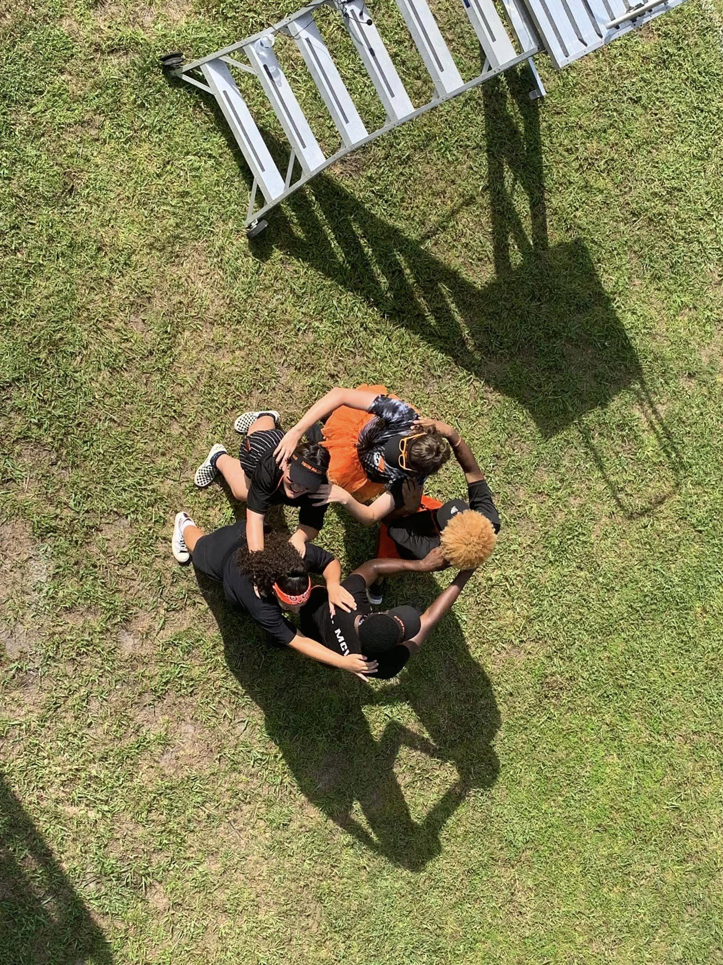
BAND CAMP
Schedule:
7/28 9am-9pm
7/29 9am-5pm
7/29 Top Golf 6-8 pm $20 PP
7/30 9am-9pm
7/31 9am-9pm
8/1 9am-9pm
8/1 @ 7pm
Band Camp Performance (Family and Friends are welcome to attend)

Slide 11
Fundraising Efforts

Slide 12
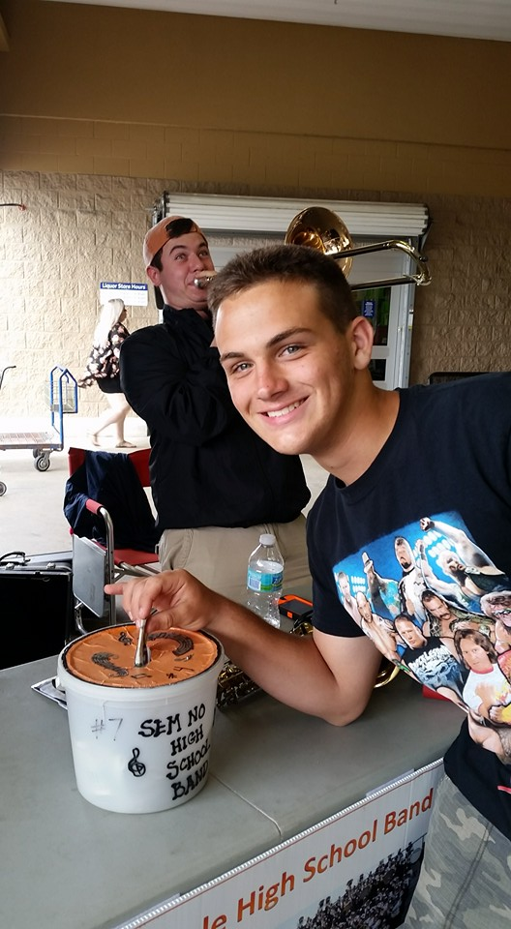
FUNDRAISING For Dues/Trips
Quarterdays
Spirit Night and other Fundraisers
Individual Fundraising / Donations
Collect donations for playing instrument or perform outside of stores
$10 into student account for adult chaperone
Portion to Band/ Rest split upon participants
Spirit Wear
Car Washes
Sweet Seminole Jazz Tickets
End of the Year Concert Tickets
Individual Sponsorship:
donations into your students account from family/friends
Place cash/check in envelope with student name (skyward), reason (dues), and amt included.
Corporate Sponsorships
Always looking to partner with local businesses.
Corporate Sponsorships

Slide 13


BAND CAMP WEEK FUNDRAISERS
TOP GOLF $20/person
Bounty
Cash or Check payment by Thursday 7/31
Reserve your spot tonight. Cash or Check payment no later than Monday
Tuesday, July 29
6-8 PM

Slide 14
PRIDE OF THE TRIBE TRIP

Slide 15
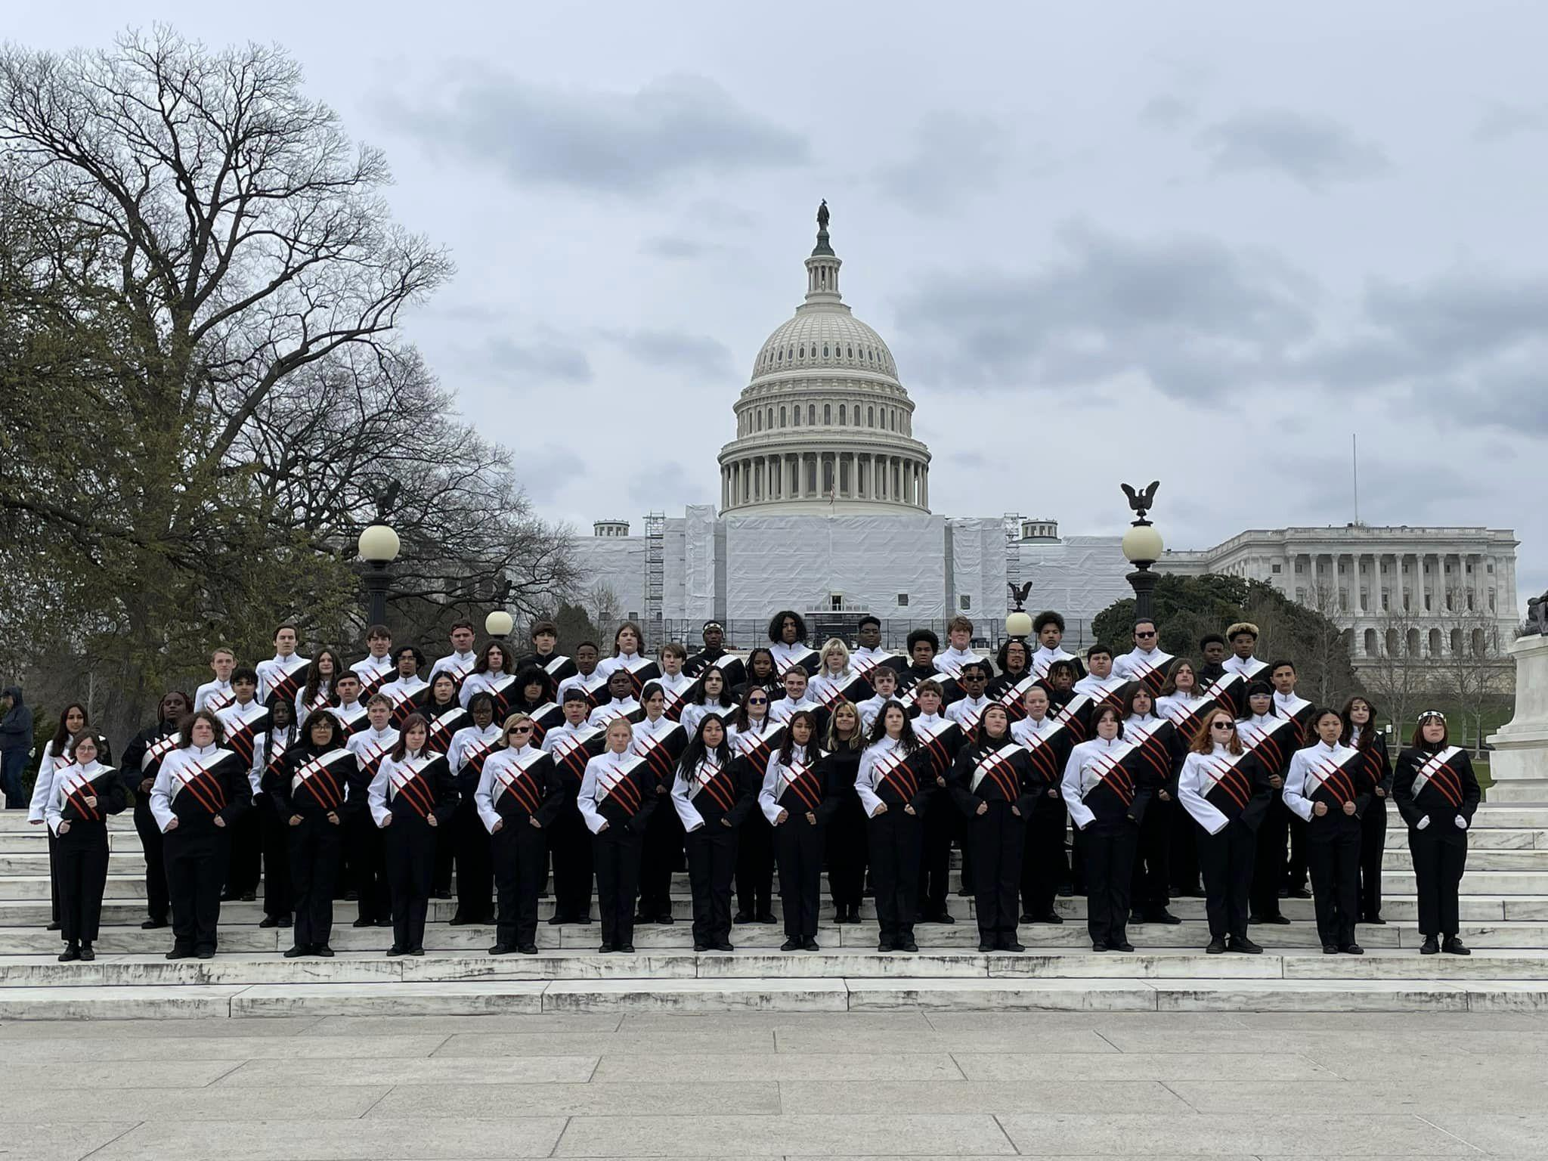
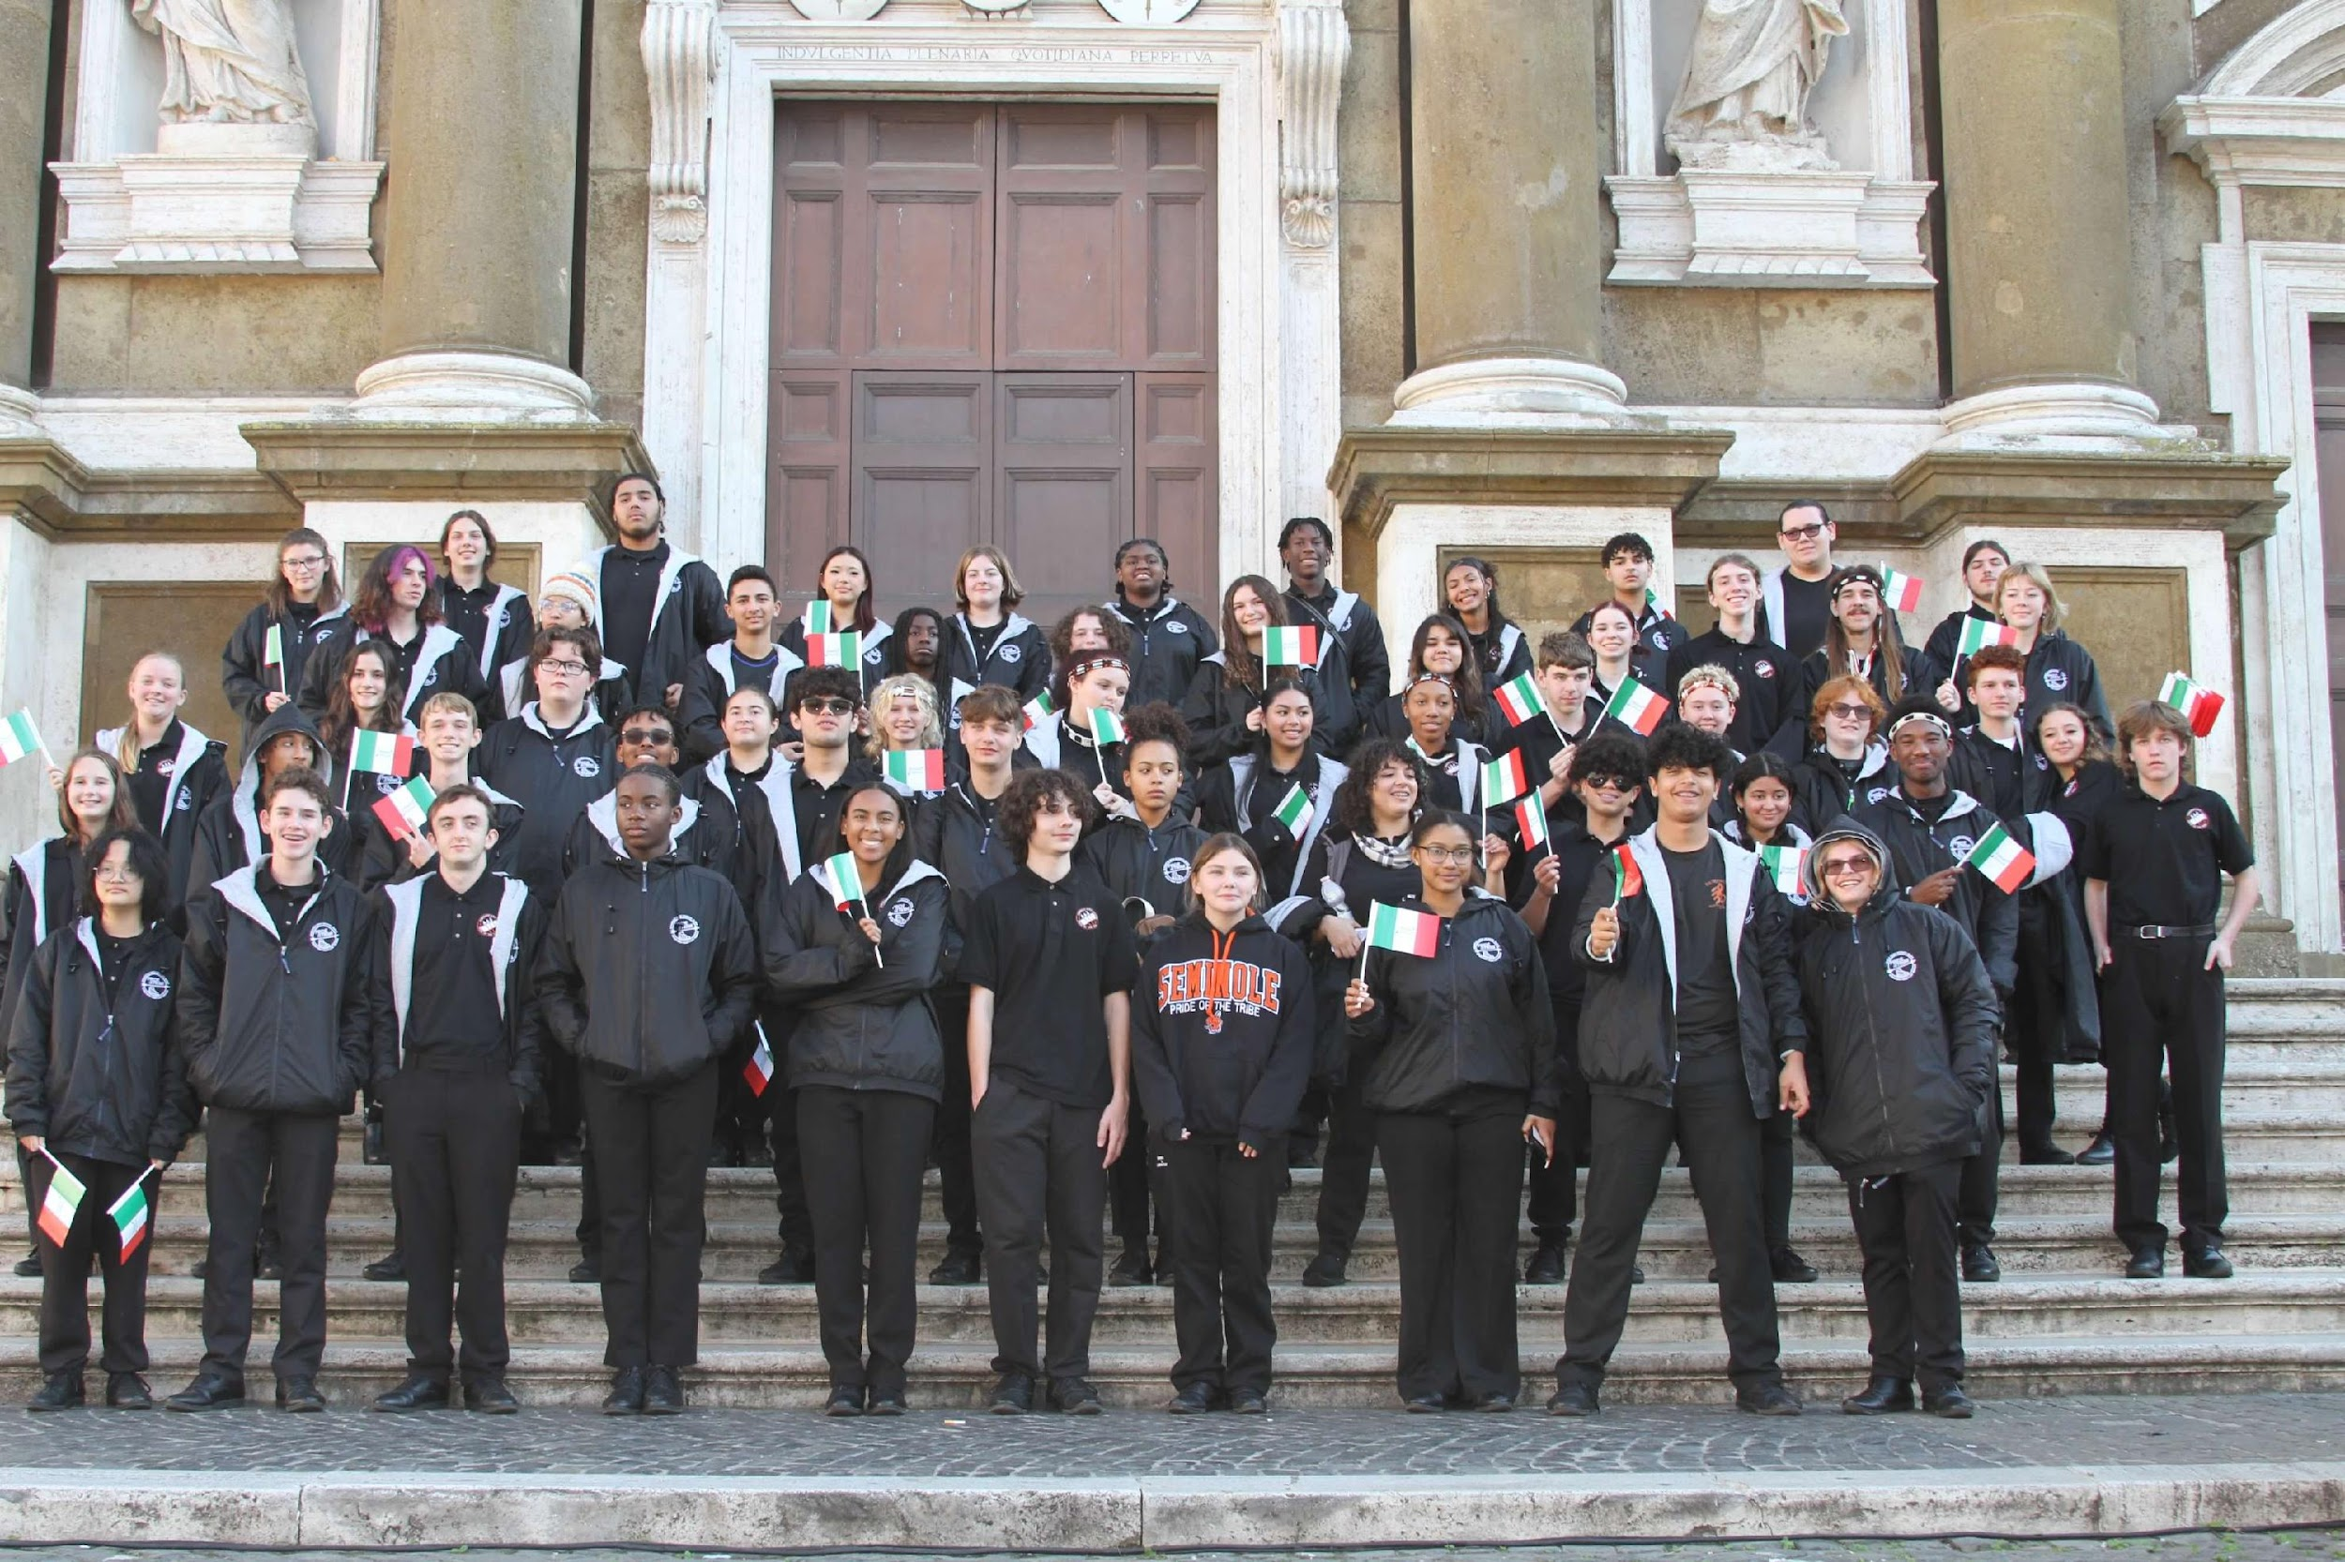

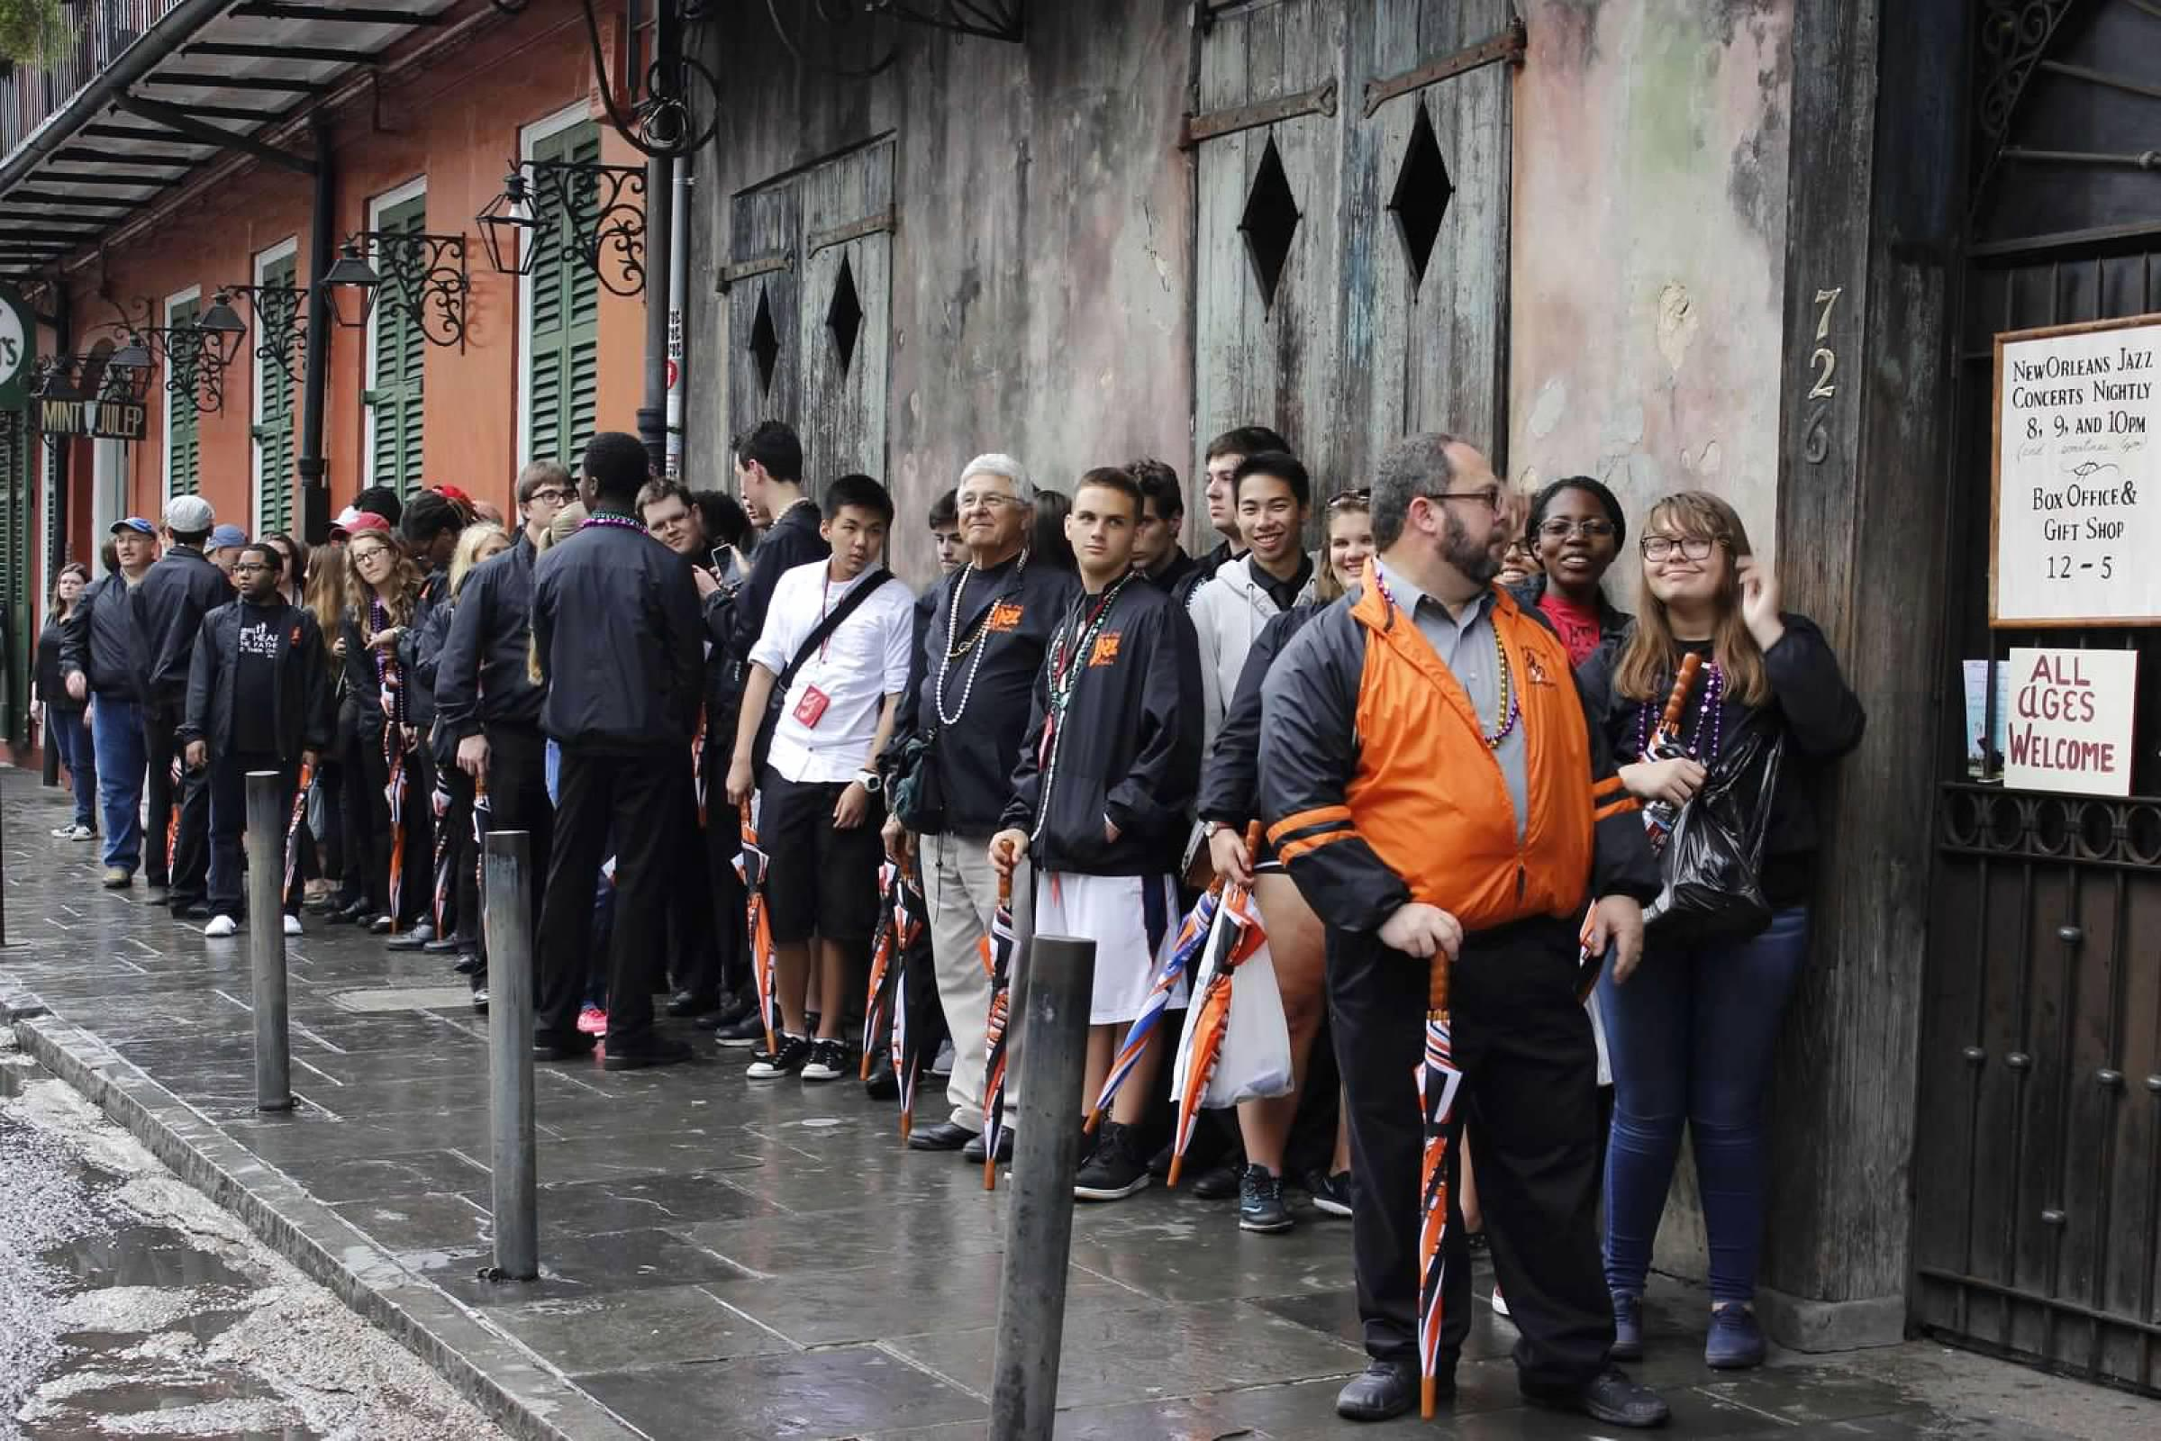
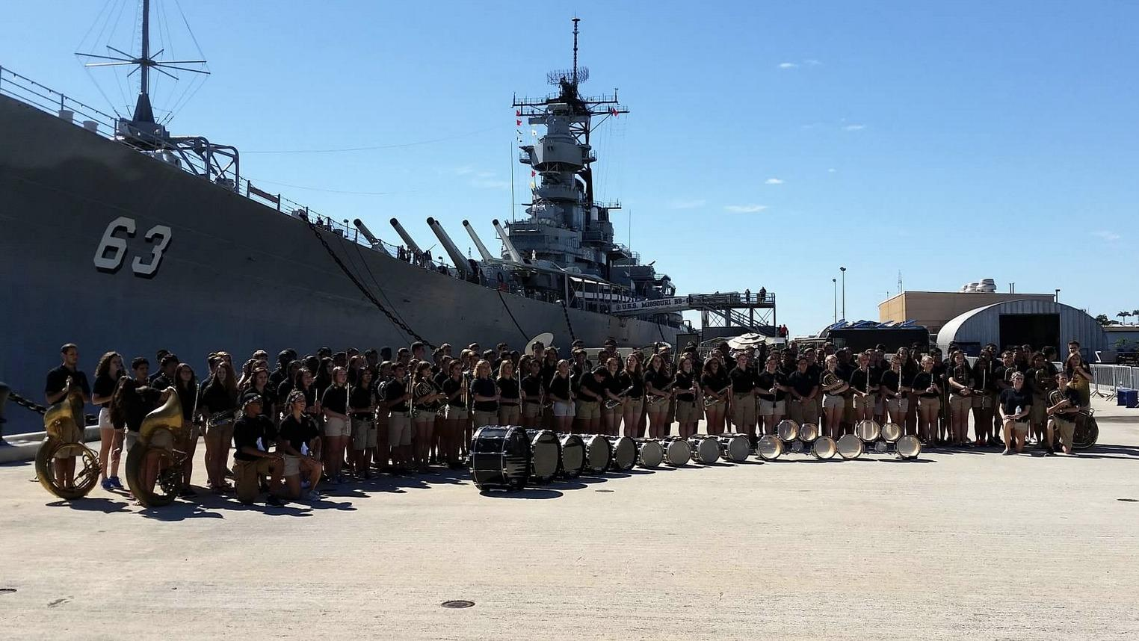
BAND TRIPS
WASHINGTON DC
ROME
LONDON
NEW ORLEANS
HAWAII

Slide 16
Spain Band Trip
01/2027
Come make memories with us. Start planning now.
  WAYS TO EARN $ TOWARDS TRIP FEES:
  Quarterdays
  Other Fundraising Efforts

Slide 17
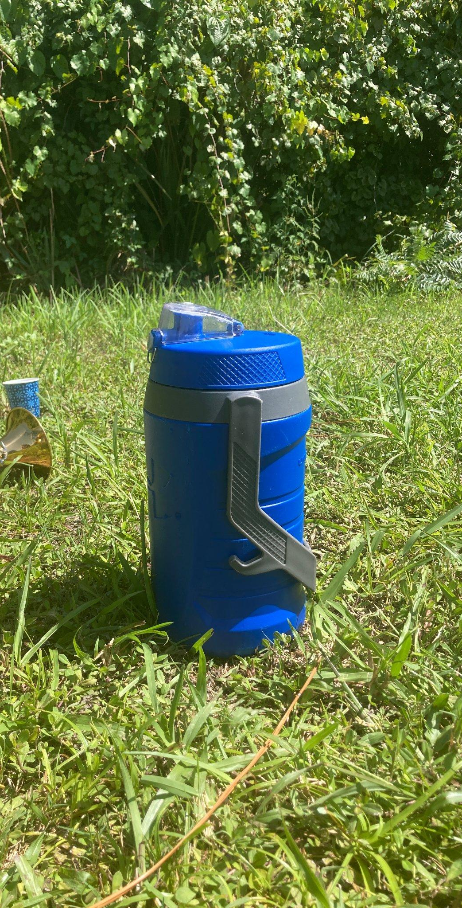
Band Camp 101 - Essentials
YOUR STUDENT NEEDS TO COME TO CAMP:
Well RESTED
Well HYDRATED
  Water is good, Gatorade is better
Well FUELED
  Having eaten breakfast each day
  BRING EVERY DAY:
  Water jug
  Lunch from home/snacks
  Sunscreen
  Deodorant
  Hat/visor/sunglasses to be worn outside
  Instrument (mouthpiece/extra reeds, etc)
  Possibly: extra shirt/socks, cooling towel
  DID WE MENTION YOUR STUDENT
  NEEDS TO BRING A WATER JUG
  EACH DAY?????

Slide 18

BAND CAMP MEALS
**MUST BE PAID FOR TONIGHT **
Scan and Fill out
Breakfast: eat at home, every morning
Lunch: bring your own, every day
Dinner: either order meals through the band boosters or bring your own
DINNER ORDERS MUST BE PLACED TONIGHT! ABSOLUTELY NO MEAL DELIVERIES ALLOWED (Grub Hub, Uber Eats, etc.)
DAY | MEAL | SINGLE ($7) | DOUBLE ($11)
MONDAY | PIZZA (Cheese or Pepperoni) | 2 SLICES | 4 SLICES
TUESDAY
WED. | CHICK FIL A or Salad | 1 SANDWICH | 2 SANDWICHES
THURS. | BURGERS (BEEF/BEAN) | 1 BURGER | 2 BURGERS
FRIDAY | PIZZA (Cheese or Pepperoni) | 2 SLICES | 4 SLICES

Slide 19
Volunteers/Chaperones
Please consider Volunteering to help the students and band program succeed.
SPOTS are STILL AVAILABLE TO HELP DURING BAND CAMP
Reach out to chaperone@seminolehsband.org

Slide 20

CONCESSION COMMITTEE-
Helps with concession stand set-up and tear down before football games and at events hosted by SHS. Sell items at concession, Chik Fil-A. Assist with inventory management
FUNDRAISING COMMITTEE-
Help planning, organizing, and running fundraisers.
Help with selling Spirit Wear Items
Quarterday Coordinator & Quarterday Assistant
Help to call stores to set up dates
Help to meet up with parents that are chaperoning to provide them with table, donation bucket, signage, and money bags.

Slide 21
BPA Volunteers
Volunteers are needed weekly during Marching season for football games:
Chik Fil-A Stand / Concession Stand:
Help to work stand
Bathroom:
Chaperones students to bathrooms
Roadie:
help with equipment set-up and tear-down for band camp, practice, football games (home & away) and at events.
Medical:
helps to provide first aid to band members and call EMS when needed.

Slide 22




DONATIONS NEEDED
Cases of soda (dr. pepper, sprite, root beer, coke, diet coke or coke zero, etc)
Individually packaged chips, cookies, snack cakes
Large Cans of Gatorade mix (powdered) (1 can = 5 gallons mixed)
Reams of plain white copy paper
ALL DONATIONS CAN BE DROPPED OFF ANYTIME DURING BAND CAMP WEEK! THEY CAN BE DROPPED OFF AT THE RAMP!

Slide 23




YOU MUST BE A DIVIDEND TO VOLUNTEER WITH US!
REGISTER AS A DIVIDEND/ RENEW YOUR DIVIDEND APPLICATION EACH YEAR BY FOLLOWING LINK IN QR CODE
SEMINOLE HS GETS CREDIT FOR THE HOURS YOU VOLUNTEER AND THIS COUNTS TOWARDS OUR SCHOOL’S RATING AND FUNDING!

